Slide 1

Forecasting Short Term Solar Energy Production
by
Manasi Mahish

Slide 2
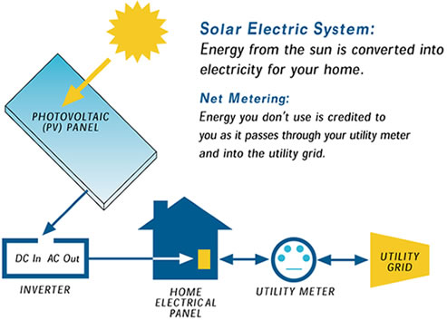
Solar energy production: current situation
Advantage
renewable
readily available
low carbon footprint
Challenge
dependent on weather variables
difficult to accurately predict time ahead
may cause the utilities to purchase emergency power from neighboring utilities while over-predicting
may cause excess generation of power while under-predicting
Solution
forecast solar energy production as accurate as possible using machine learning algorithms

Slide 3
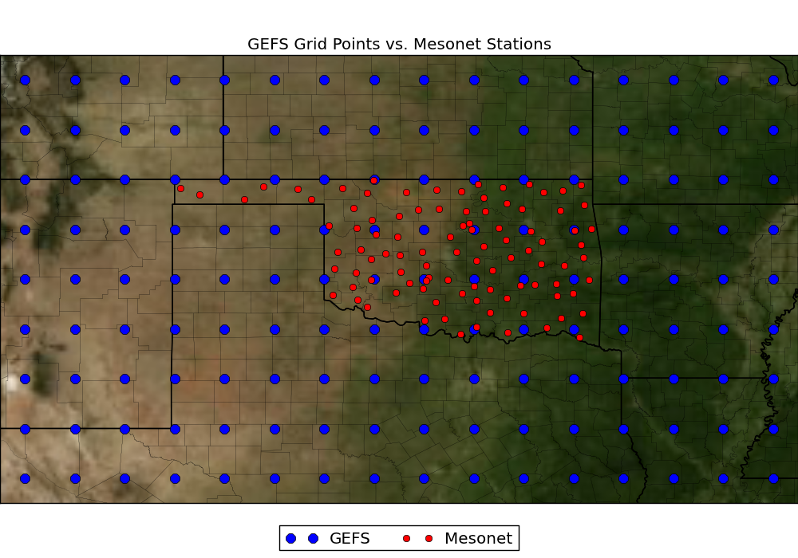
Scope of the work
39N, 254W
39N, 269W
Forecast solar energy production at 98 Mesonet stations (red)
Input data: Numerical weather prediction (NWP) model data from NOAA/ESRL Global Ensemble Forecasting System (GEFS) for 1° apart grid points (blue)
Model: machine learning algorithm- linear regression, gradient boosting, random forest
Target metrics: Normalized root mean square error (NRMSE) as 0.05 and correlation coefficient as 0.9 between predicted and actual solar energy production
31N, 254W
31N, 269W

Slide 4
Data description
Data structure: 5113 (days) x 11 (model ensemble) x 5 (times /day) x 9 (latitude) x 16 (longitude)
Input data
Radiative flux: downward long-wave radiative flux at surface (DLWRFS), downward short-wave radiative flux at surface (DSWRFS), upward long-wave radiation at surface (ULWRFS), upward short-wave radiation at surface (USWRFS), upward long-wave radiation at top of the atmosphere (ULWRF)
Temperature: maximum temperature at 2 m above ground (MaxT), minimum temperature at 2 m above ground (MinT), current temperature at 2 m above ground, temperature of surface (T)
Other variables: air pressure at mean sea level (Pr), 3-Hour accumulated precipitation at surface (Precip), precipitable water over entire depth of atmosphere (PW), specific humidity at 2 m above ground (H), total cloud cover over entire depth of atmosphere (TCC), total column-integrated condensate over entire atmosphere (TC)
Target variable
Solar energy production
Training data: 1994 – 2007 weather (input) and solar energy (output) data
Model prediction: 2008 – 2012 solar energy production based on weather data

Slide 5
Reshaping data structure
39N, 254W
39N, 269W
Extract weather data for individual grid points – 5 (33 – 37N) x 10 (257 – 266 W) GEFS points
Reshaping table structure from 3 dimension to 2 dimension: (5113, 11, 5) to (5113, 55)
Write to file
37N, 257W
37N, 266W
33N, 257W
33N, 266W
31N, 254W
31N, 269W

Slide 6
Estimating at individual mesonet station
Weather data of 4 surrounding GEFS pts (blue)
reshaping: from 2d (5113 x 55) to 1d (281215)
Check
Null values
Summary statistics
frequency distribution of weather features at 4 GEFS
correlation among them
Assumption: gradual change in weather features
Combine and average 11 model prediction at each timestep
Average over 5 timesteps - daily average
Linear interpolation (2 dimensional) on daily average from 4 GEFS points to estimate variable at each mesonet station (red)
x1,y2
x2,y2
x,y
x1,y1
x2,y1

Slide 7
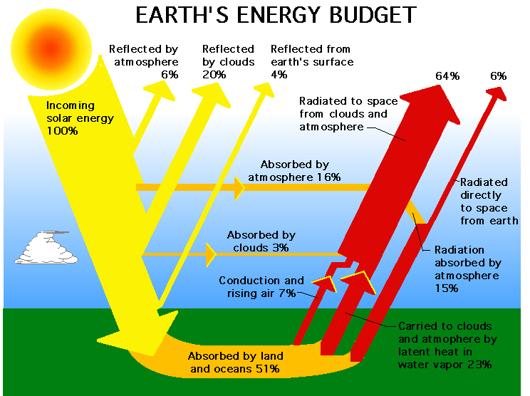
Exploratory analysis: radiative flux
Radiative Flux: Amount of solar energy radiated through a given area
Incoming radiation ~ shortwave, high energy, emitted from very hot sun
Upward radiation ~ longwave, low in energy, re-emitted by much cooler earth
A small fraction goes back to space
https://kisialevelgeography.wordpress.com/as-atmosphere-weather/

Slide 8
Derived features: radiation
Downward radiation at surface, down = DSWRFS + DLWRFS
Total energy received at surface
Upward radiation at surface, up = USWRFS + ULWRFS
Total energy radiated from surface
Net radiation at surface, net = down – up
Total energy retained by surface
Fraction of downward radiation reemitted from surface, up_frac = up/down
Shortwave radiation as fraction of incoming radiation, ds_by_dn = DSWRFS/down
Longwave radiation as fraction of re-emitting radiation, ul_by_up = ULWRFS/up
Longwave radiation at TOA as fraction of downward radiation, fr_atm_s = ULWRF/down
What fraction is lost in space

Slide 9
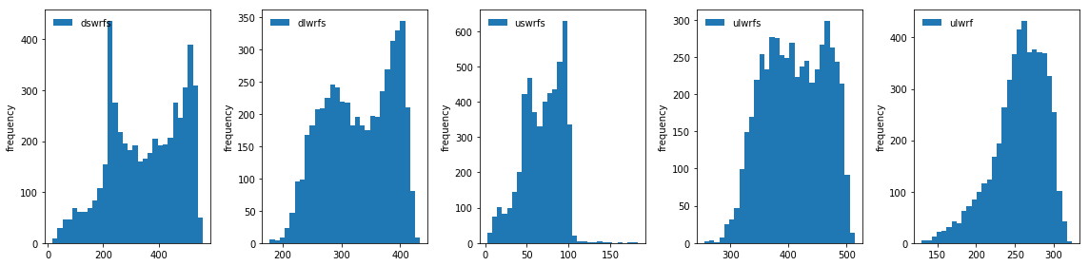
Frequency distribution: radiative flux
1
2
3
4
5
Downward flux with 2 distinct peaks - summer and winter (1, 2)
Downward shortwave - highest magnitude (1)
Upward shortwave– lowest magnitude (3)
Upward flux – longwave primarily (4)

Slide 10
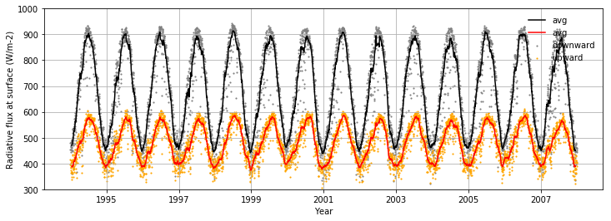
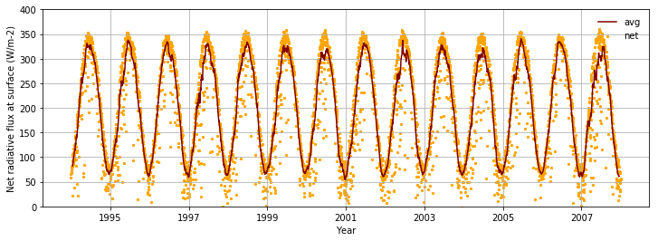
Time series analysis: radiative flux
Daily average at ‘ACME’
Downward radiation: shortwave (mainly) + longwave
Upward radiation: shortwave + longwave (mainly)
Net radiation at surface: downward – upward
Seasonality evident in downward, upward and net radiation at surface
Seasonality caused by tilt of earth (primarily ) + various weather elements

Slide 11
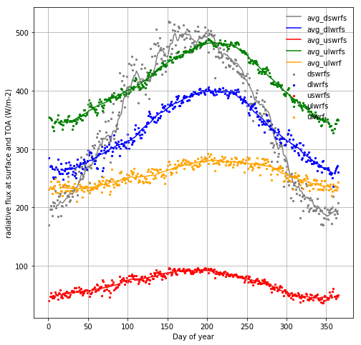
Seasonal variation in radiative flux
Summer solstice
Seasonality in downward shortwave is greatest
A change of 200 to 500 units between winter low to summer high
All radiations high in summer and lower in winter
There is time lag between the peaks of various radiations
Re-emitted long wave peaks in July, later than the shortwave
Shortwave peak~ June solstice

Slide 12
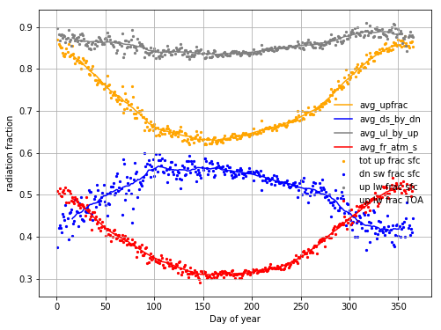
Seasonal variation in radiation fraction
The fraction of energy re-emitted from earth surface (orange), up/down, is less in summer
Downward shortwave radiation as fraction of total downward radiation (blue), DSWRFS/down, is higher in spring and summer
DSWRFS high in summer
Cloud-cover, pollutants, aerosols
Upward longwave radiation as fraction of total upward radiation (gray), ULWRFS/up, > 80%
Upward longwave radiation at TOA as a fraction of total downard radiation at surface (red), ULWRF/down, is less in summer months, similar to up/down
Notes:
up_frac = up/down, ds_by_dn = DSWRFS/down, ul_by_up = ULWRFS/up, fr_atm_s = ULWRF/down. Shortwave fluctuates more than longwave. So the peak in summer(blue)

Slide 13
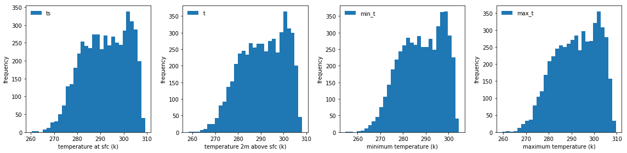
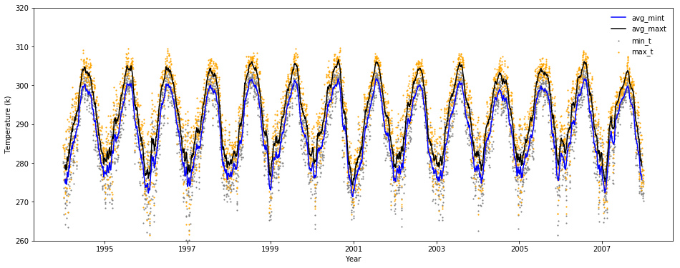
Frequency & time series analysis: temperature
Distribution similar for all temperature measurements
Temperature closely tied to the amount of radiation at surface
Seasonality evident with high in summer and low in winter

Slide 14
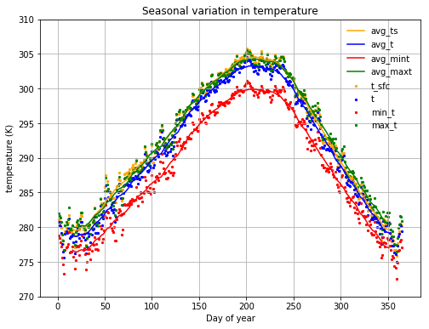
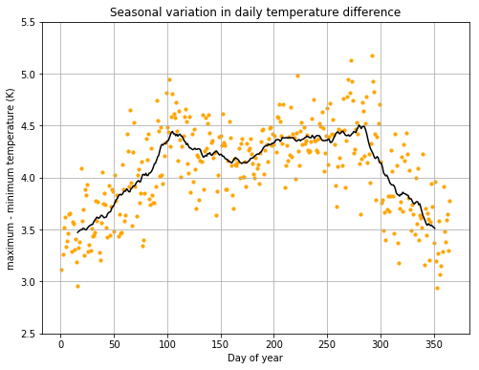
Seasonal variation in temperature
Seasonality evident in temperature
Temperature at surface (orange) higher than temperature above surface (blue) due to higher temperature gradient near surface
Difference in daily maximum and minimum temperature higher during spring and fall, and lower in winter

Slide 15
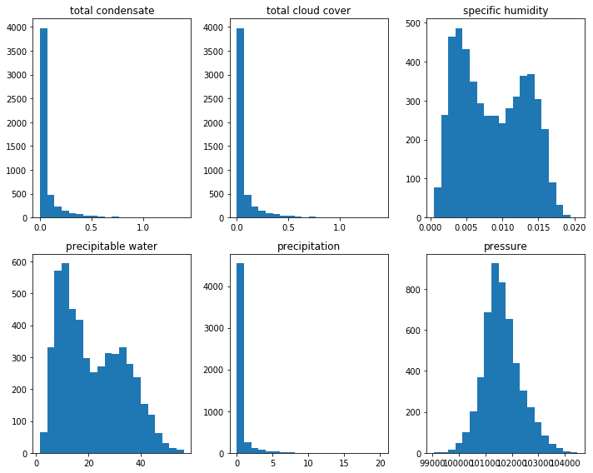
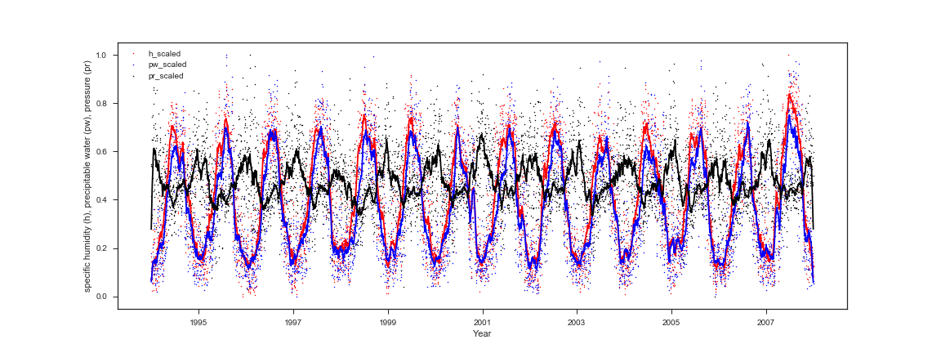
Frequency & time series analysis: other variables
Total condensate, cloud cover and precipitation : most data near first bin
Specific humidity and precipitable water with bimodal distribution, similar to temperature, large number of humid and dry days
Pressure more normally distributed
Seasonality in specific humidity, precipitable water and pressure
Specific humidity and precipitable water high in summer low in winter
Pressure high in winter and low in summer

Slide 16
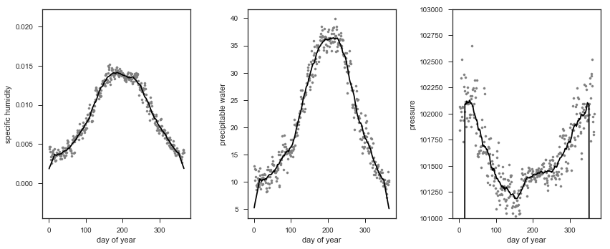
Seasonal variation in humidity and pressure
Seasonality evident in specific humidity, precipitable water and pressure – specific humidity, and precipitable water high in summer and low in winter, pressure low in summer and high in winter

Slide 17
Correlation analysis with the target variable
Variable | Correlation coefficient with target | Variable | Correlation coefficient with target
DSWRFS | 0.888 | T | 0.627
USWRFS | 0.843 | MinT | 0.580
net | 0.826 | H | 0.432
dn | 0.826 | DLWRFS | 0.351
Up | 0.776 | PW | 0.254
ULWRF | 0.660 | Pr | -0.227
TS | 0.644 | Precip | -0.309
ULWRFS | 0.633 | TC | -0.487
MaxT | 0.628 | TCC | -0.487
The radiations in general strongly correlated with solar energy
Downward shortwave radiation primary source of energy - highest correlation with solar energy production
Pressure having minimal effect on solar energy
Total cloud cover (TCC), total condensate (TC), precipitation negatively affect solar energy; more atmospheric moisture, more absorption of radiation by the atmosphere, less energy reaching surface

Slide 18
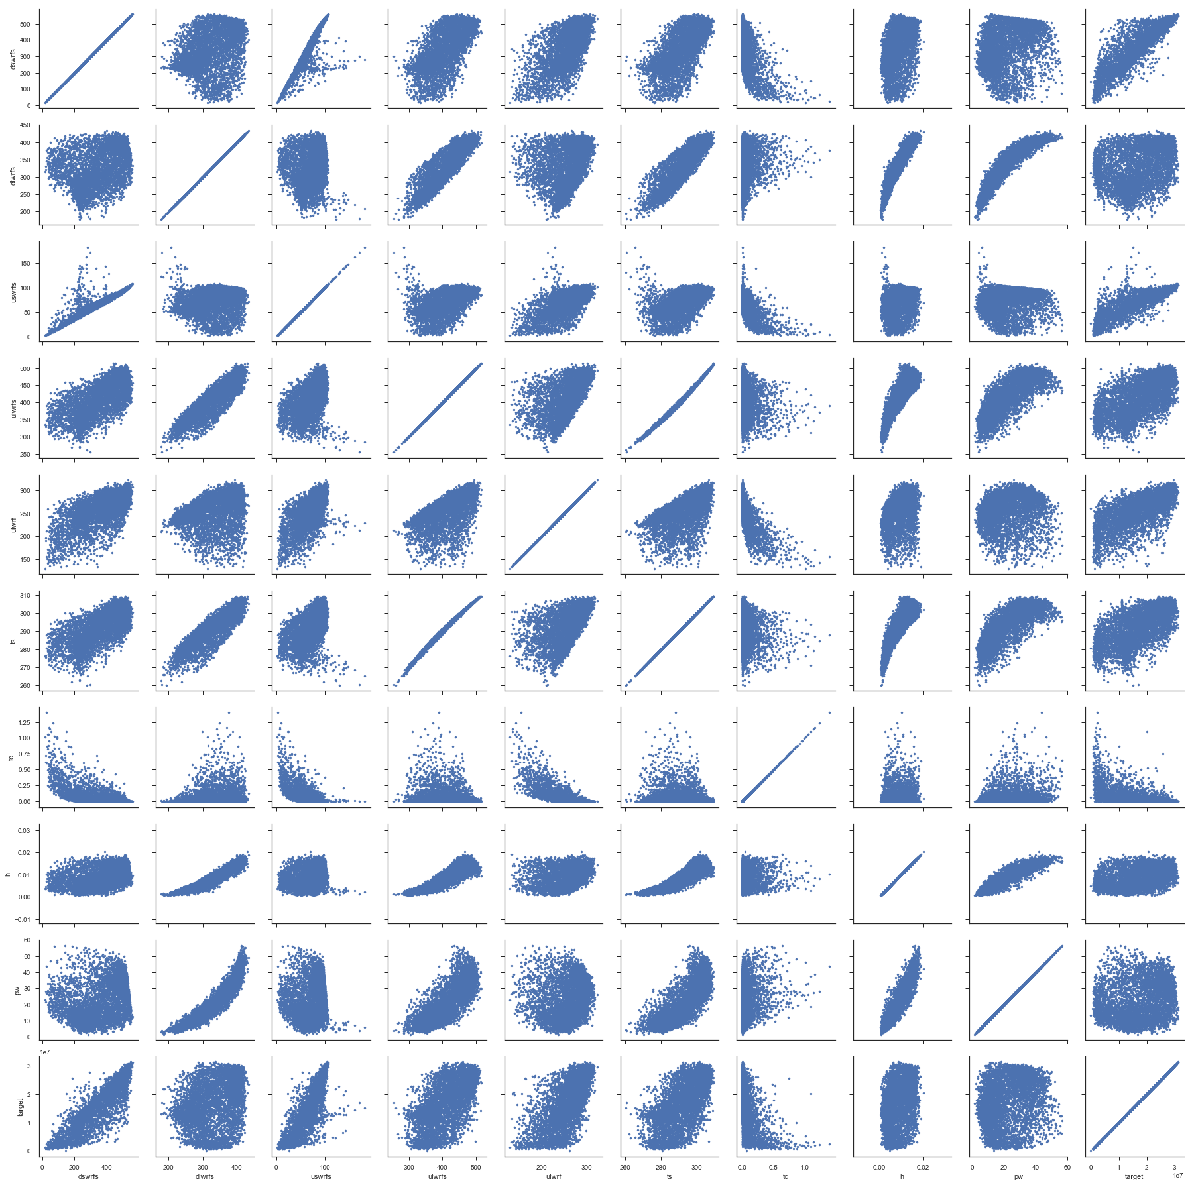
1 2 3 4 5 6 7 8 9 10
DSWRFS
DLWRFS
USWRFS
ULWRFS
ULWRF
TS
TC
H
PW
Target

Slide 19

Model prediction: choosing the right model
Simple model
Underfitted dataset
High bias
Low variance
Generalized
Complex model
Overfitted dataset
Low bias
High variance
Not generalized
Flexible
Objective: build a model with optimum model complexity

Slide 20
Machine learning algorithm
Linear regression
Simple model
Assumed linear relations between features and target variable
Bias high, variance low
Gradient boosting
Built on weak regressors
Sequential process
Following regressor learns from previous regressor’s mistake
Random forest
Decision trees prone to overfitting
Parallel process
Higher number of decision trees employed to process re-sampled data
Relies on voting to average out overfitting
Computationally expensive

Slide 21
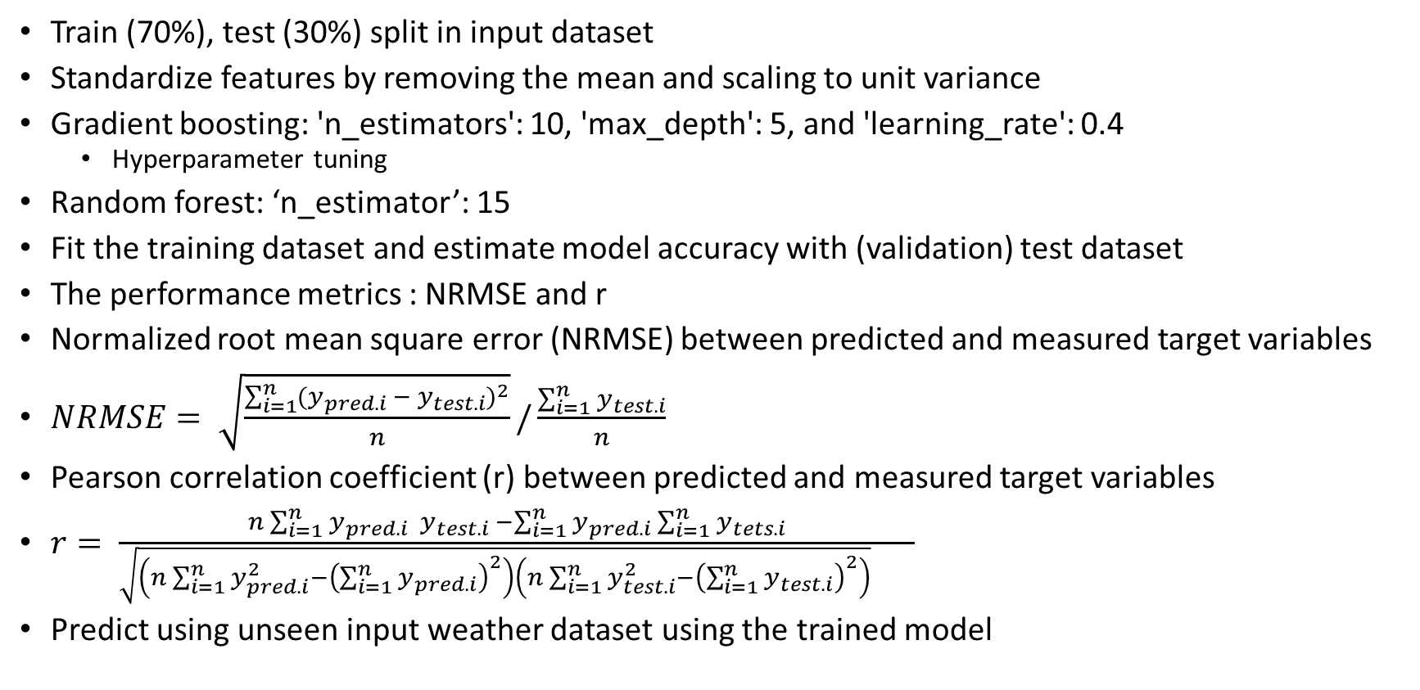
Modeling steps
Train (70%), test (30%) split in input dataset
Standardize features by removing the mean and scaling to unit variance
Gradient boosting: 'n_estimators': 10, 'max_depth': 5, and 'learning_rate': 0.4
Hyperparameter tuning
Random forest: ‘n_estimator’: 15
Fit the training dataset and estimate model accuracy with (validation) test dataset
The performance metrics : NRMSE and r
Normalized root mean square error (NRMSE) between predicted and measured target variables
$NRMSE= \sqrt{\frac{\sum_{i=1}^{n}{{(y_{pred.i} − y_{test.i})}^{2}}}{n}}/\frac{\sum_{i=1}^{n}{y_{test.i}}}{n}$
Pearson correlation coefficient (r) between predicted and measured target variables
$r= \frac{n\sum_{i=1}^{n}{y_{pred.i}{ y}_{test.i}} −\sum_{i=1}^{n}{y_{pred.i}\sum_{i=1}^{n}{y_{tets.i}}}}{\sqrt{\left(n\sum_{i=1}^{n}{y_{pred.i}^{2}}−{\left(\sum_{i=1}^{n}{y_{pred.i}}\right)}^{2}\right)\left(n\sum_{i=1}^{n}{y_{test.i}^{2}}−{\left(\sum_{i=1}^{n}{y_{test.i}}\right)}^{2}\right)} }$
Predict using unseen input weather dataset using the trained model

Slide 22
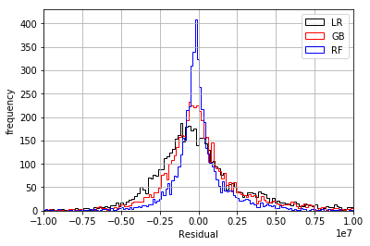
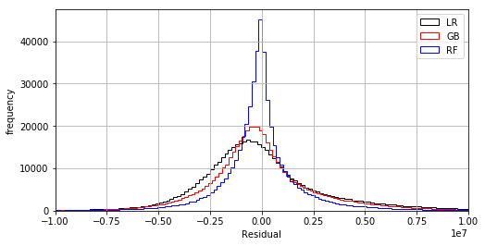
Residual distribution of ML algorithms
ACME station
All 98 stations

Slide 23
Comparisons of ML algorithms
Machine learning | Error components |  | Parameters | NRMSE / Correlation coefficient
 |  |  |  | Station 'ACME' |  |  |  | All stations
 | bias | variance |  | All features |  | Radiative flux only |  | All features
 |  |  |  | NRMSE | Corrcoef | NRMSE | Corrcoef | NRMSE | Corrcoef
Linear regression | high | low | default | 0.191 | 0.912 | 0.2 | 0.901 | 0.2 | 0.909
Gradient boosting | high | low | n_estimator = 10 | 0.194 | 0.934 | 0.194 | 0.902 | 0.204 | 0.932
Random forest | low | high | n_estimator = 15 | 0.19 | 0.967 | 0.201 | 0.958 | 0.206 | 0.961

Slide 24
Conclusion
The target NRMSE (0.05) was not achieved but the target correlation coefficient (0.9) was obtained in all cases
Solar energy was predicted appropriately using weather inputs
Radiative data alone effectively predicts solar energy with some error margin
Similar accuracy achieved using 3 ML algorithms
Linear regression is the simplest and chosen model for solar energy prediction

Slide 25



Slide 26
